Slide 1

NYC_TAXI_TRIP DURATION
ARYAMOL K S
PGDAWE01

Slide 2
Dataset : nyc_taxi_trip_ duration
From : Kaggle

Slide 3
Challenges with the Data
Latitude and Longitude values are present in the dataset
Converting and creating new columns in the dataset
First model has a high RMSE value

Slide 4
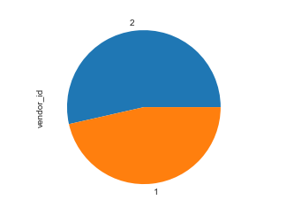
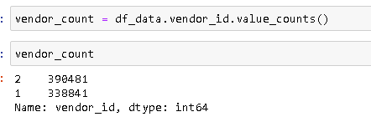
Major Findings through EDA (‘trip duration’ – Response Variable)
There is no big difference between vendor id(categorical feature)

Slide 5
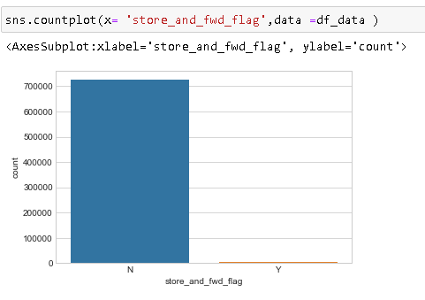
Major Findings through EDA
Found one irrelevant factor in EDA,called store_and_fwd_flag
Store_and_fwd_flag =This flag indicates whether the trip record was held in vehicle memory before sending to the vendor because the vehicle did not have a connection to the server (Y=store and forward; N=not a store and forward trip)

Slide 6
Data cleaning and Manipulation
Create new columns(eg-trip distance,avg_trip_speed etc)
Scaling of columns(date format changing)
Dropped irrelevant columns(id,pick up_longituge. pick up_latitude.etc)
Change vendor id as an ‘object’
Trip duration(target variable) transformed by takin log values.

Slide 7
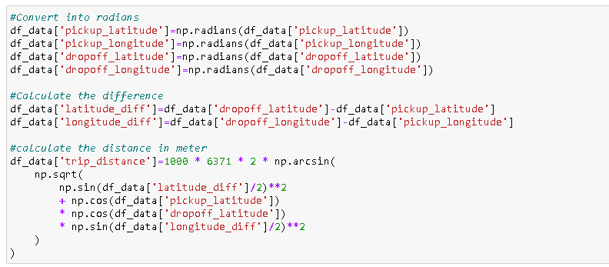
Data cleaning and Manipulation Action 1 :
Create new columns(eg-trip distance,avg_trip_speed etc)

Slide 8
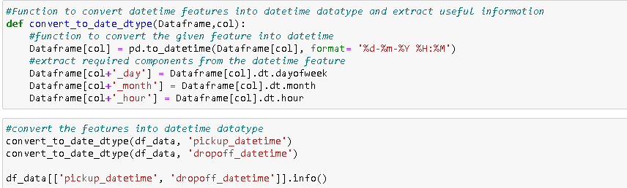
Data cleaning and Manipulation Action 2 :
Scaling of columns(date format changing)

Slide 9

Data cleaning and Manipulation Action 3 :
Dropped irrelevant columns(id,pick up_longituge. pick up_latitude.etc)

Slide 10
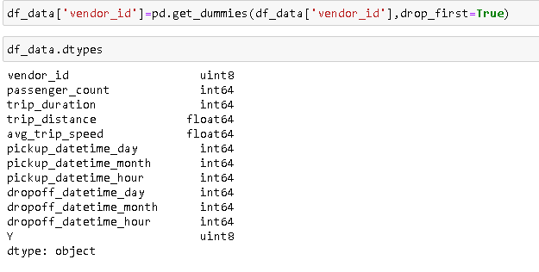
Data cleaning and Manipulation Action 4 :
Change vendor id as an ‘object

Slide 11
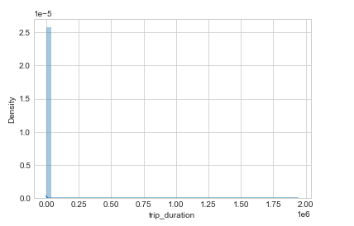
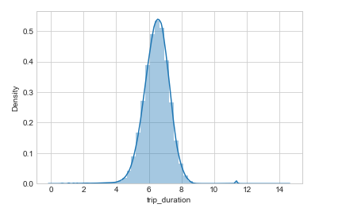


Data cleaning and Manipulation Action 5 :
Trip duration(target variable) transformed by taking log values.

Slide 12
What are the Algorithms used?
Different types of algorithms used
Types of algorithms:
Decision tree
KNN
Bagging
XGB regressor
Gradient Boost
WHY??=Our target variable(trip duration) is continues. After built the first linear regression shows a high RMSE value(cost function). So I applied different algorithms and check the accuracy and RMSE value

Slide 13
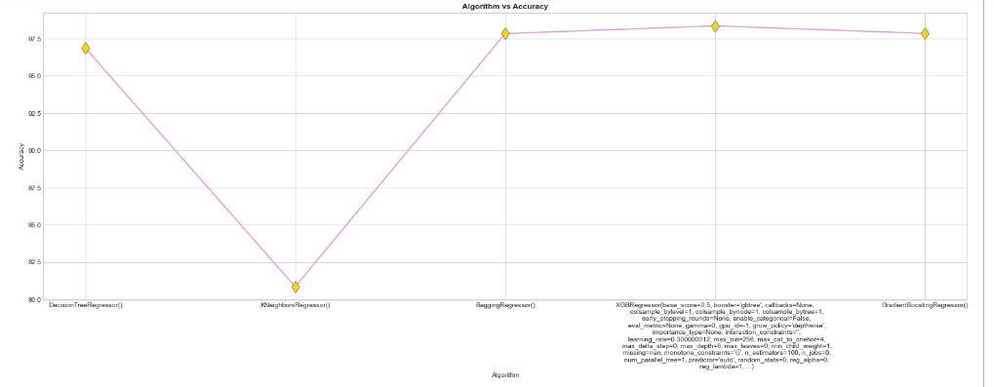
Models : Accuracy

Slide 14
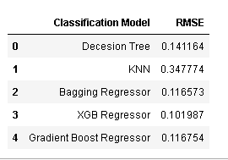
Comparing RMSE values

Slide 15
CONCLUSION
Found XGB Regressor is the best ,it has comparatively less RMSE value(0.101987) and high accuracy level=98.33%

Slide 16

THANK YOU

